Slide 1
Hackathon 2026
Presented by-: Revant,Suryansh and Suryansh
TEAM HK 08

Slide 2
AI-Based Retail Sales Trend Analysis
Corporate Sales Forecasting Presentation
Prepared for Management Review

Slide 3
Executive Summary
• 2-Year sales data analyzed
• Seasonal and festive trends identified
• AI model predicts future demand
• Next Month Forecast: 2067.25
Goal: Improve inventory & pricing decisions

Slide 4
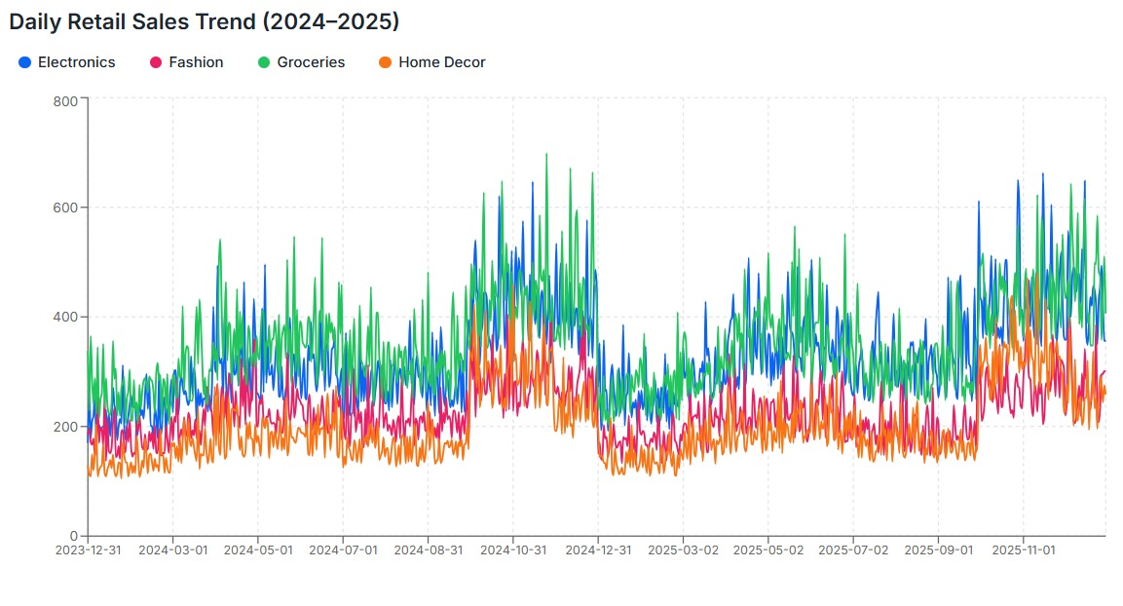
2-Year Sales Performance

Slide 5
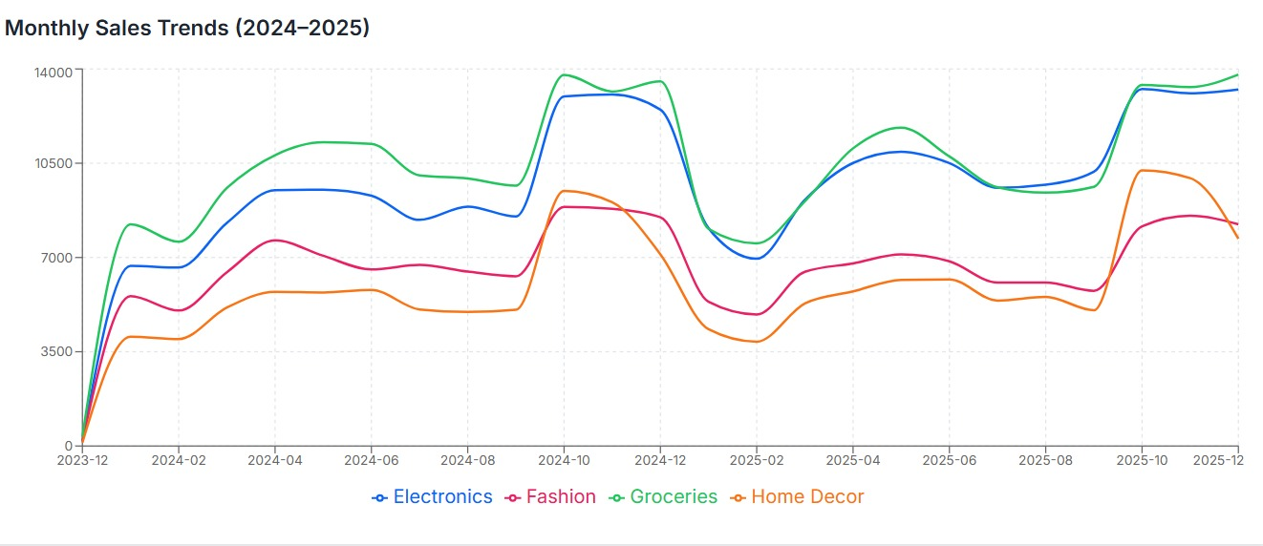
Sales Pattern & Seasonality

Slide 6
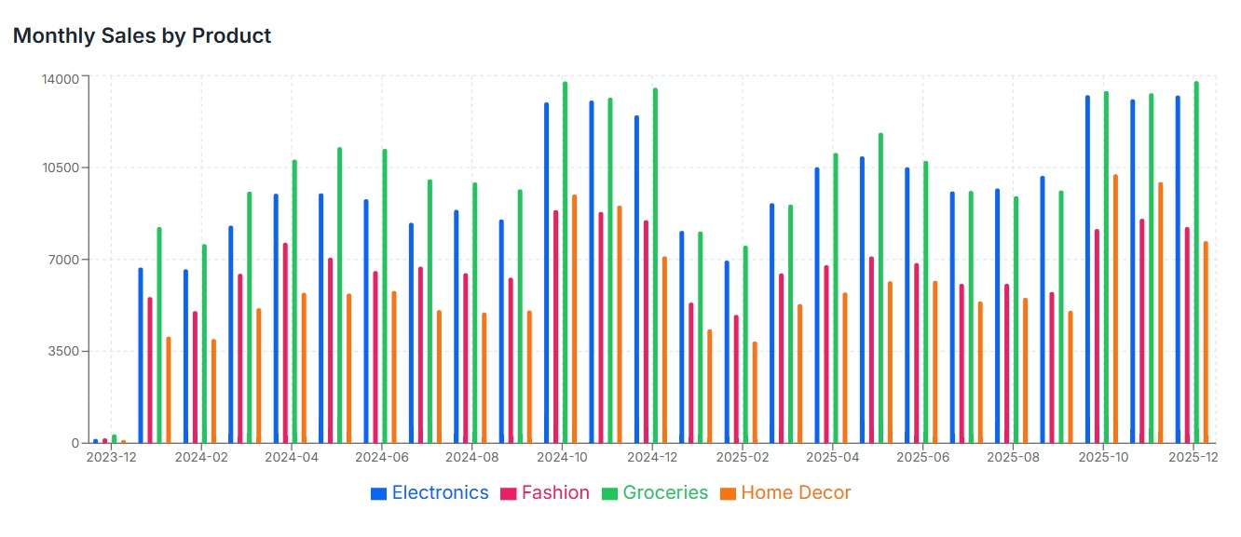
AI Forecasting Model Output

Slide 7
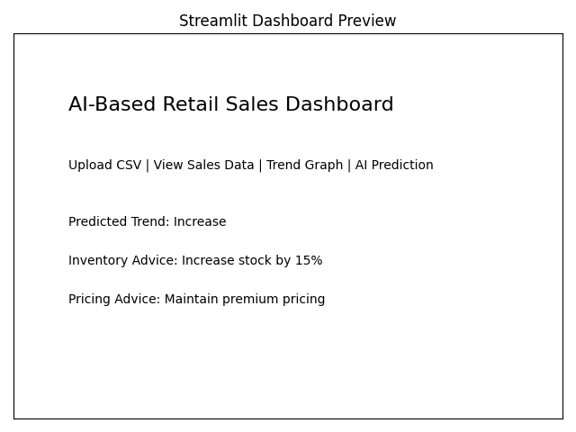
Retail Sales Dashboard (Streamlit UI)

Slide 8
Strategic Recommendations
Inventory Strategy:
• Increase stock before festive months
• Reduce inventory during low-demand periods
Pricing Strategy:
• Premium pricing during high demand
• Targeted discounts during slow months
Expected Result:
Higher profitability & reduced stock wastage

Slide 9
Conclusion
AI-driven forecasting improves business planning.
Data-backed decisions reduce risk.
Retailers can proactively manage demand fluctuations.

